Slide 1

Heart Disease Prediction Using Machine Learning
PROJECT GUIDE SUBMITED BY
DR E SRIMATHI RA2231241020040
V.C.ROSHAN
III BCA - A

Slide 2
Project Overview
The Heart Disease Prediction System uses machine learning to detect heart disease based on clinical data like age, BMI, cholesterol, and etc. It follows steps like data processing, model training, and deployment. A Streamlit-based UI allows users to enter data and get instant predictions, helping in early detection and better treatment planning.

Slide 3

Agenda
Defines the architecture, components, and data flow of the Heart Disease Prediction System
Main Components:
Modules Explanation
Data Flow Diagram (DFD)
Architecture Diagram
Database Design
Machine Learning Model

Slide 4

Modules Explanation
User Interface (Frontend - Streamlit)
Collects user input: Age, BMI, Blood Pressure, Cholesterol, etc.
Displays heart disease prediction results (Risk: Present/Absent).
Data Processing Module
Cleans and normalizes data.
Encodes categorical variables.

Slide 5
Modules Explanation
Machine Learning Model (Prediction Engine)
Loads the trained model.
Predicts heart disease risk based on input.
Database Management Module
Stores patient data and clinical records.
Saves and retrieves prediction results.
Model Training & Evaluation Module
Trains ML models using clinical datasets.
Evaluates and selects the best-performing model.

Slide 6
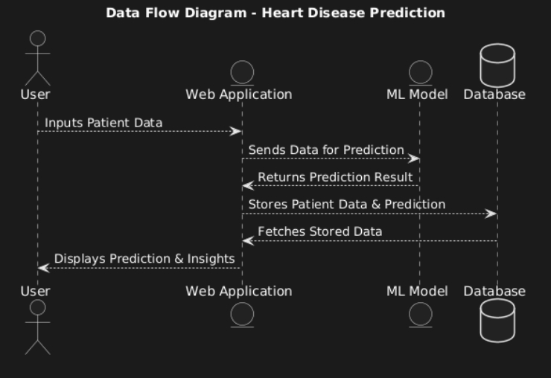
Data Flow Diagram

Slide 7
Data Flow Diagram Explanation
User inputs patient data into the Web Application.
The Web Application sends this data to the ML Model for prediction.
The ML Model processes the data and returns the prediction result.
The prediction and patient data are stored in the Database.
The Web Application can fetch stored data from the Database.
Finally, the Web Application displays the prediction and insights to the User.

Slide 8
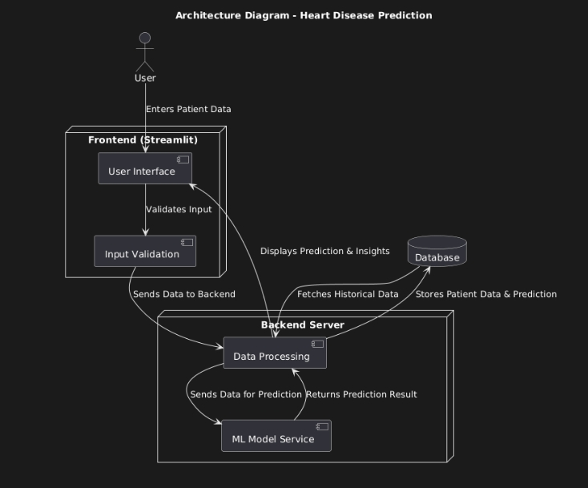
Architecture Diagram

Slide 9
Architecture Diagram Explanation
User enters patient data via the Frontend (Streamlit), which has a User Interface and Input Validation.
The validated data is sent to the Backend Server, where it undergoes Data Processing.
The ML Model Service receives the processed data, makes a prediction, and sends the result back.
Predictions and patient data are stored in the Database.
Historical data can be fetched from the Database for insights.
The Frontend displays predictions and insights to the User.

Slide 10
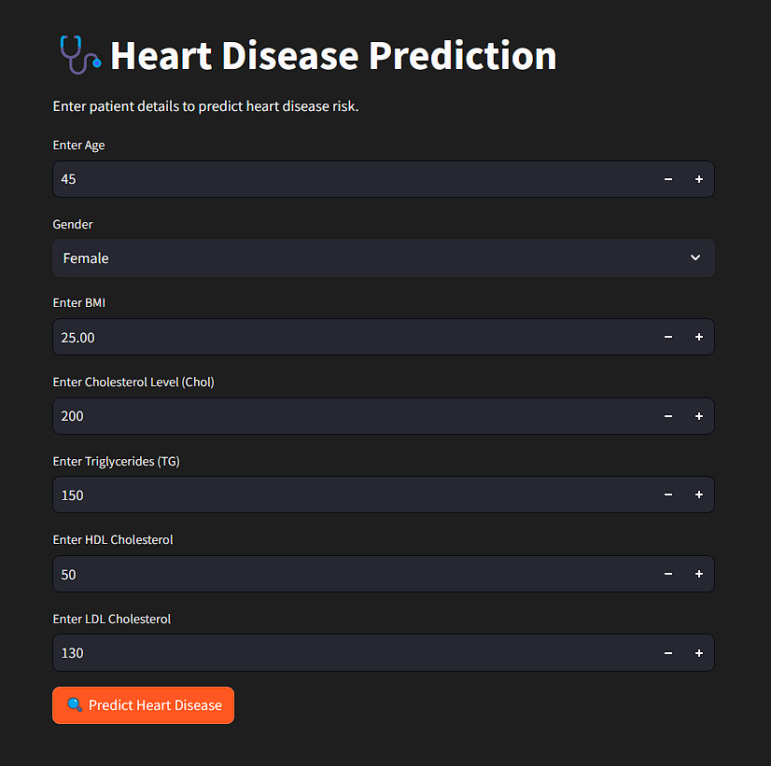
STREAMLIT

Slide 11
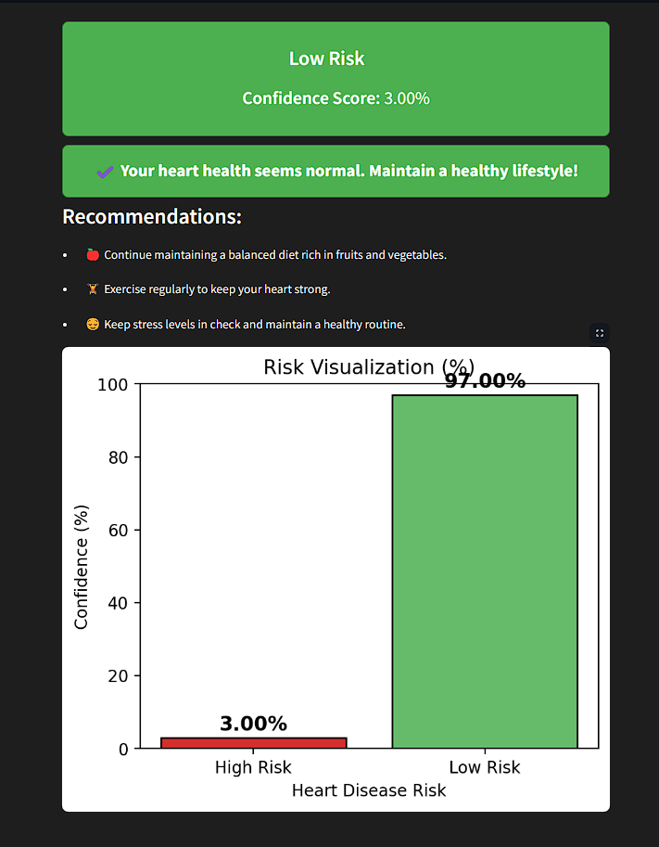
STREAMLIT

Slide 12
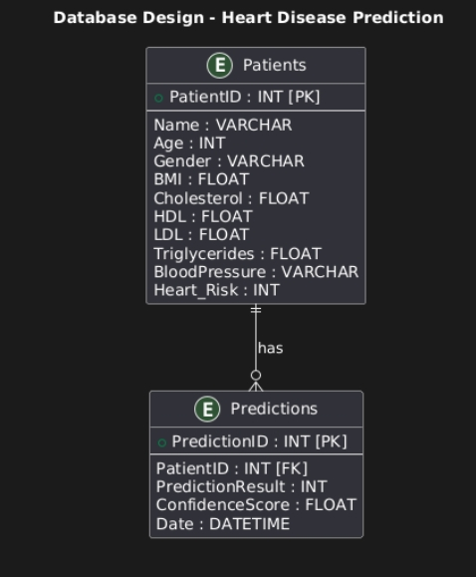
Database Schema Diagram

Slide 13
Database Design
The system uses a relational database to store patient records, clinical data, and predictions.
Key Tables:
Patient Table: Stores basic patient details.
Clinical Data Table: Stores medical parameters for prediction.
Prediction Table: Stores model-generated results.
Ensures efficient data retrieval and storage for accurate predictions.

Slide 14
Database Schema
Patient Table: [ PK – Primary Key
PatientID (PK), Name, Age, Gender, Contact FK – Foreign Key ]
Clinical Data Table:
ClinicalDataID (PK), PatientID (FK), BMI, Cholesterol, HDL, LDL, Triglycerides, Heart_Risk
Prediction Table:
PredictionID (PK), PatientID (FK), ClinicalDataID (FK), PredictionResult, ConfidenceScore, Timestamp

